Slide 1
EMPATHY
TARGET USER
Understanding the Student
🎓
The Last-Minute Studier
Who are they? What do they feel?
Students preparing for exams
with limited time left
💭 THINK
❤️ FEEL
"I can't find the right resources"
"Where do I even start?"
"There's too much — no time!"
Overwhelmed & anxious
Frustrated by scattered info
Pressured by exam deadlines
📌 Last-minute study behavior
📌 Difficulty finding reliable materials
⚡ DO
🗣 SAY
📌 Information overload before exams
Search multiple platforms
Ask classmates for notes
Cram content the night before
"I wish there was one place"
"Audio > reading long notes"
"Last minute prep is my reality"
📌 Resources scattered everywhere
PrepPulse • Design Thinking

Slide 2
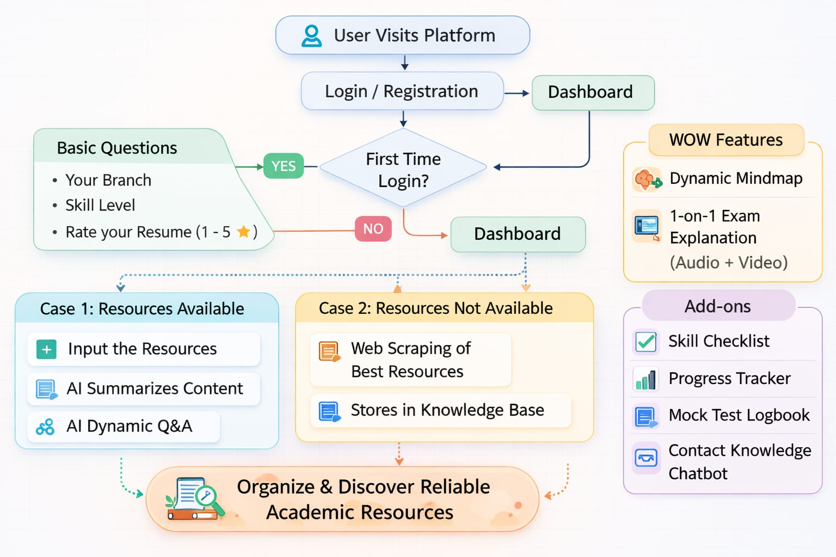
DEFINE
SOLUTION FLOW
Defining the Problem
HMW Statement
How might we help students quickly discover reliable academic resources that align with their course requirements?
01
Last-minute study behavior is the norm among exam-season students
02
Reliable, course-aligned materials are hard to locate quickly
03
Information overload disrupts focus — listening beats reading for speed
TASKS:
Analyse student patterns | Design resource systems | Develop a discovery platform
PrepPulse • Design Thinking

